Slide 1
Motion Planning for Multiple Autonomous Vehicles
Dynamic Distributed Lanes
Presentation of the paper: R. Kala, K. Warwick (2014) Dynamic Distributed Lanes: Motion Planning for Multiple Autonomous Vehicles, Applied Intelligence, DOI: 10.1007/s10489-014-0517-1
Rahul Kala

Slide 2
Why Graph Search?
Completeness
Optimality
Issues
Computational Complexity
Key Idea
State Reduction: Select which states to expand

Slide 3
Key Contributions
The generalized notion of lanes is defined.
The generalized notion is used for planning and coordination of multiple vehicles.
A pseudo centralized coordination technique is designed which uses the concepts of decentralized coordination for iteratively planning different vehicles but empowers a vehicle to move around the other vehicles. The coordination is hence better in terms of optimality and completeness than most approaches (discussed so far) while being somewhat computationally expensive in the worst cases.
The concept of one vehicle waiting for another vehicle coming from the other direction is introduced, when there may be space enough for only one vehicle to pass.
Heuristics are used for pruning the expansions of states, which result in a significant computational efficiency while leading to a slight loss of optimality.

Slide 4
Defining (Virtual) Lanes
Properties
Distributed | The number of lanes and their widths may change in different segments of the road
Dynamic | The lanes change along with time for every pathway as the vehicles pass by.
Single Vehicle | No two vehicles may occupy a lane side-by-side
Variable Width | Every lane has a different width

Slide 5
Solution Approach
A general graph (here Uniform Cost Search) search can be used with:
High resolution maps
Rich action set for the vehicle
To solve within computational time, the number of states expanded needs to be restricted
Coordination strategy needs to be devised

Slide 6
State Reduction
Reduction hypothesis:
Vehicles maximize lateral separations
Vehicles prefer to travel at same lateral positions along the road

Slide 7
State Expansion
Consider expansion of a state L
Problem is selecting child states L formed as a result of the expansion
Only expansion step of the graph search algorithm is discussed in this work, while the rest of the algorithm is same as a general graph search.

Slide 8
Considering only a Single Vehicle

Slide 9
State Reduction
Use a sweeping line (Z) for obstacle analysis in large steps
Select regions of line (Pathways) in obstacle free regions
Select best point inside every pathway (L₃)
Make these children and connect to parent (L) by a smooth trajectory
Select similar point (L₂) at an earlier sweeping line (Z₂)
Feasibility analysis
Vehicle Placement Hypotheses
(i) Maximize lateral separations
(ii) Attempt to drive in same relative position at the road

Slide 10
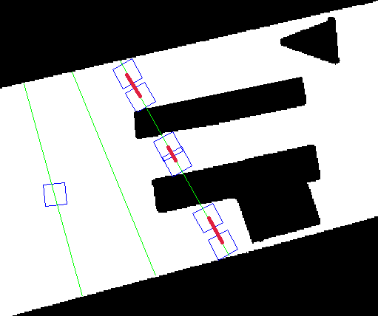
State Reduction
Vehicle position at extremity of pathway
All pathways
(3 expansions to be done)
Y’
L
A pathway
Sweeping line used for obstacle analysis (Z)
Earlier sweeping line for expanded node (Z₂)

Slide 11
Why use L₂ and not L₃?
Or why select a state not at the sweeping line but earlier?
Or why Z₂ and not Z?
Best point L₃
Obstacle
L
Z
Sweeping Line
But if vehicle lands at L₃, it cannot steer sharp enough and avoid the obstacle

Slide 12
Why L₂ and not L₃?
Vehicle expected to align itself at L₂ for obstacle seen at L₃
If vehicle can go from L to L₃ via L₂, it is safe at L₂
Curve from L to L₂ may be traversed if optimal
Curve from L₂ to L₃ is only for connectivity check/obstacle analysis
L₃ acts as a roadmap for L₂ informing it about any obstacle well in advance before the vehicle actually lands

Slide 13
State Selection
Z₂
Z
Planned Trajectory
Trajectory only for analysis
L
L₃
L₂

Slide 14
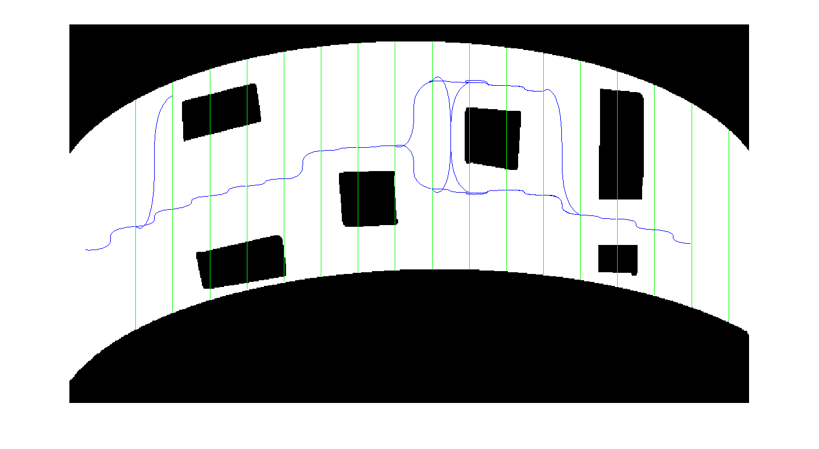
State Selection
Every turn is on the basis of obstacle assessed at the next sweeping line while states are selected on the basis of the set hypotheses.

Slide 15
Curve Generation
Connect L to L2 by a clothoid curve
Connect L2 to L3 by curve along the road length
Check feasibility
If infeasible, perform local optimization
If still infeasible, reduce speed/sweeping line step size and repeat

Slide 16
Small Obstacle Problem
Z₂ (modified)
Z (modified)
Z₂ (original)
Z (original)
L₃ (modified)
L₃ (original)
L₂ (modified)
L
L₂ (original)
small obstacle
Z (original) cannot be used for obstacle analysis as it cannot detect the small obstacle and hence always return infeasibility. Hence it is modified to Z (modified) by reduction in step size of the sweeping line. Corresponding Z₂s are Z₂ (original) and Z₂ (modified)

Slide 17
Lane
Graph search gives the shortest path as output
Result consists of trajectory and all the expanded states
The expanded states together with available lateral bounds constitute a Lane
Trajectory may be modified by moving the expanded states laterally

Slide 18
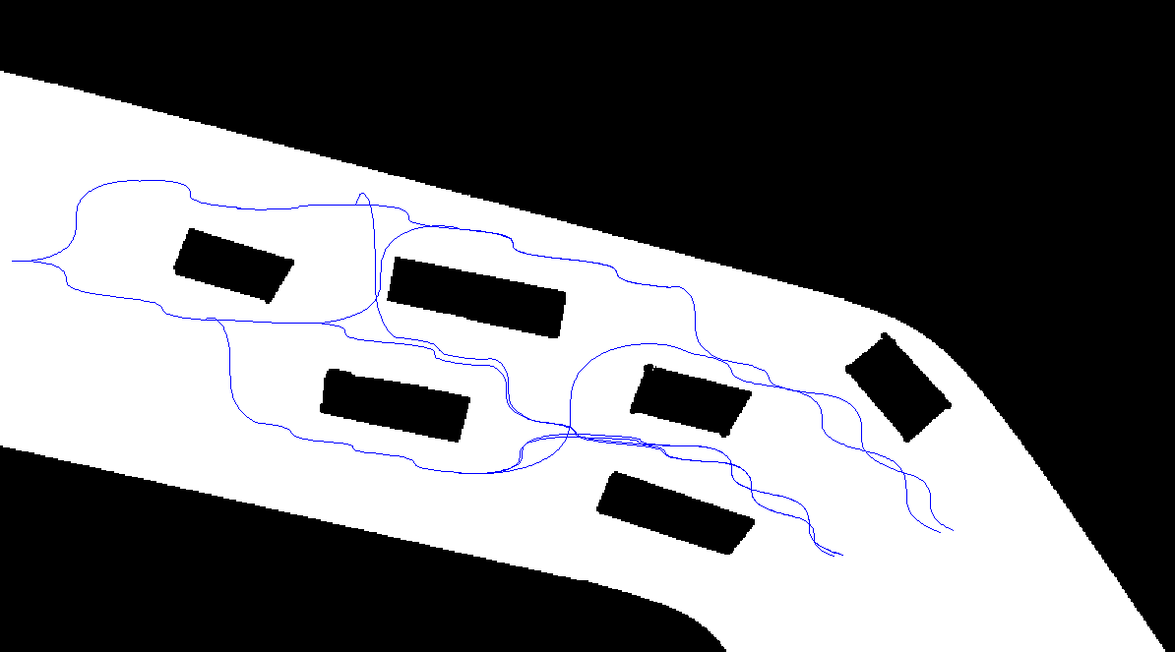
Graph generated

Slide 19
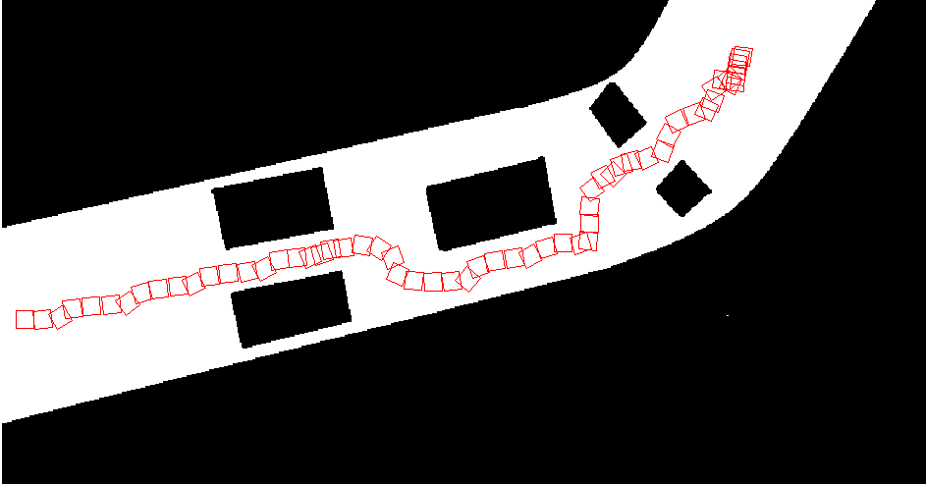
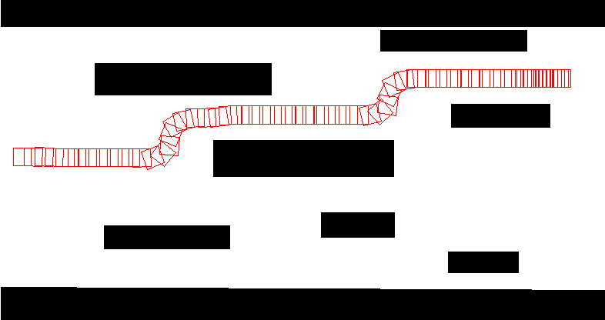
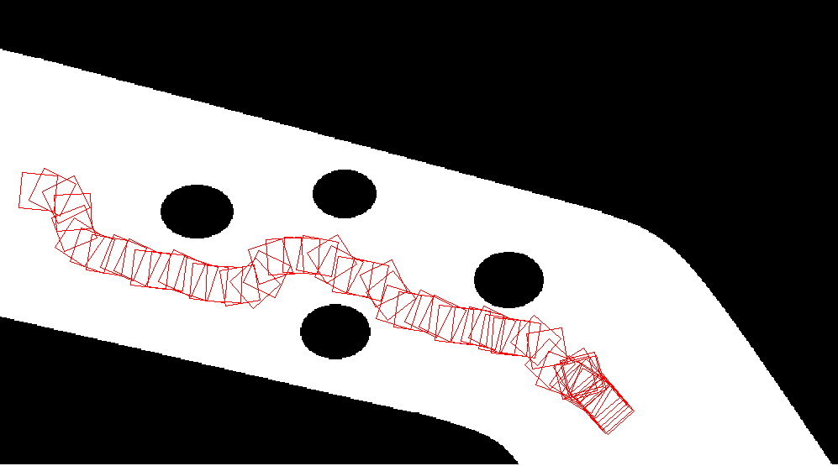
Results

Slide 20
Considering Multiple vehicles

Slide 21
Problem
A number of vehicles with planned trajectories and lanes are given
Construct plan of the next vehicle entering the scenario
The trajectories of the other vehicles may be modified by changing their lanes (moving their expanded states laterally)

Slide 22
Expansion Strategy
Expansion Strategy
Free State Expansion
Vehicle Following
Wait for Vehicle

Slide 23
Free State Expansion
Expand using maximum speed, overtaking expansion strategy
Use sweeping line for obstacle analysis
Compute vehicles requiring independent lane
For every pathway
Distribute pathway width amongst the vehicles
Vehicle being followed or going ahead by a larger speed not considered
To skip details go to slide 32

Slide 24
Strategy
Find vehicles (R_{c}) affected by altered navigation of R_{a} or R_{b} and hence also require a separate lane
Find vehicles (R_{d}) affected by altered navigation of R_{a}, R_{b} or R_{c} and hence also require separate lane
Find vehicles (R_{b}) affected by navigation of vehicle under planning (R_{a}) to Z and hence require a separate lane
And so on till no vehicle is further affected

Slide 25
Region of independent lane
Region within which all vehicles have independent lanes
Region of independent lanes (S)
Add S₂
Check if a vehicle in H while travelling in S affects any other vehicle R_{j}
Calculate region (S₂) in which R_{j} assumes a new lane
Vehicles requiring independent lanes (H)
Add R_{j}

Slide 26
Calculating new affected region
Let R_{i} be the vehicle being planned
Let R_{j} be the vehicle affected
Let R_{k} be any other vehicle which might be affected by R_{j}
R_{j} moves to new lane as soon as possible (a)
R_{j} returns to original planned lane after crossing navigation region of R_{i} (L to Z) , say (b)
New lane is effective in (a) to (b)
While R_{j} travels from (a) to (b), it should not affect any other vehicle (R_{k}). If yes, it is also added, and so on

Slide 27
Calculating affected region
(a)
(b)
(b)
(a)
R_{j}
R_{j}
R_{j}
R_{j}
R_{j}
R_{j}
R_{i}
R_{i}
R_{i}
R_{i}
Motion from L to Z
Same side
Opposite sides

Slide 28
Calculating affected region
While R_{j} travels from (a) to (b) , some R_{k} also travels as per its trajectory
Does R_{j} effect R_{k}, in which case the affected region and vehicles are updated and the process repeats?
Since motion of R_{j} from (a) to (b) is yet to be computed, approximations are used

Slide 29
Calculating affected region
R_{j}
R_{j}
R_{k}
R_{k}
(a)
(b)
(a)
(b)
Same Side
If R_{k} is safe with R_{j} at (b), it is not affected, distances will only increase with R_{k} moving forward
Opposite Sides
If R_{k} moved by a threshold (proportional to speed) is safe with R_{j} at (b), it is not affected. With time R_{k} will get closer to R_{j} and may get affected. Maximum threshold assumed.

Slide 30
Lane Distribution
Get vehicles requiring independent lane
Get preferred position for vehicle being planned
Check if placement possible without moving other vehicles
If not, check if placement possible with maintenance of maximum separation threshold
If not, compute total free space and distribute between vehicles evenly

Slide 31
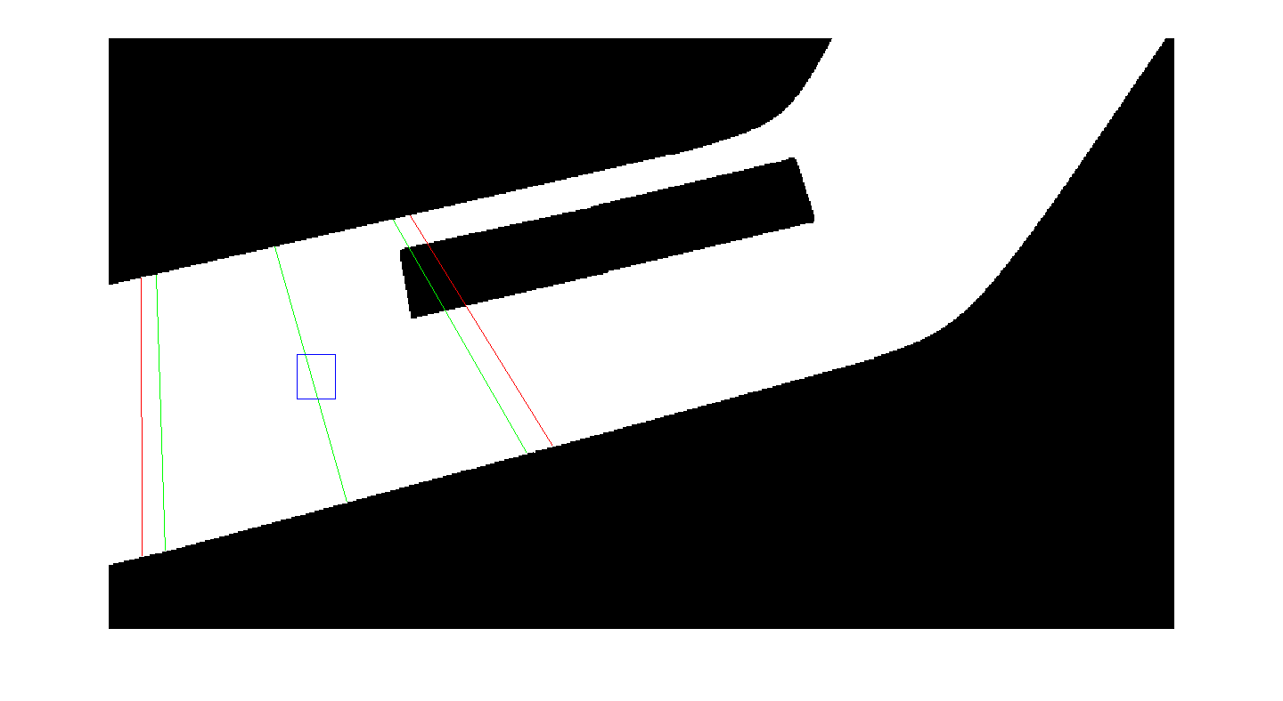
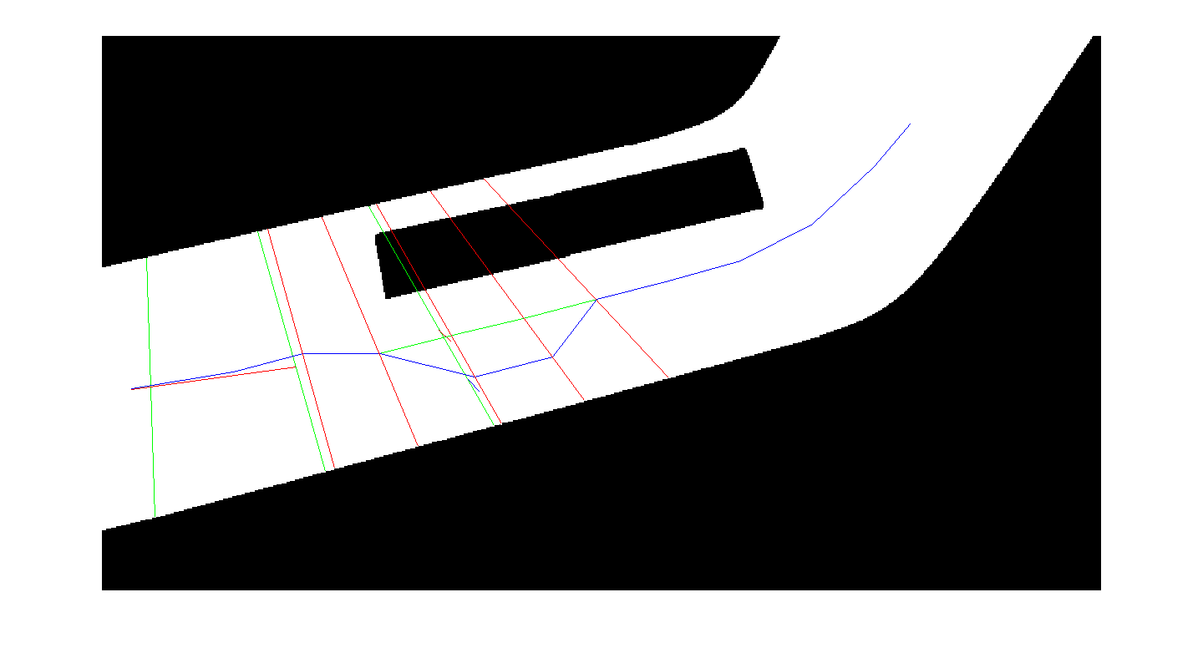
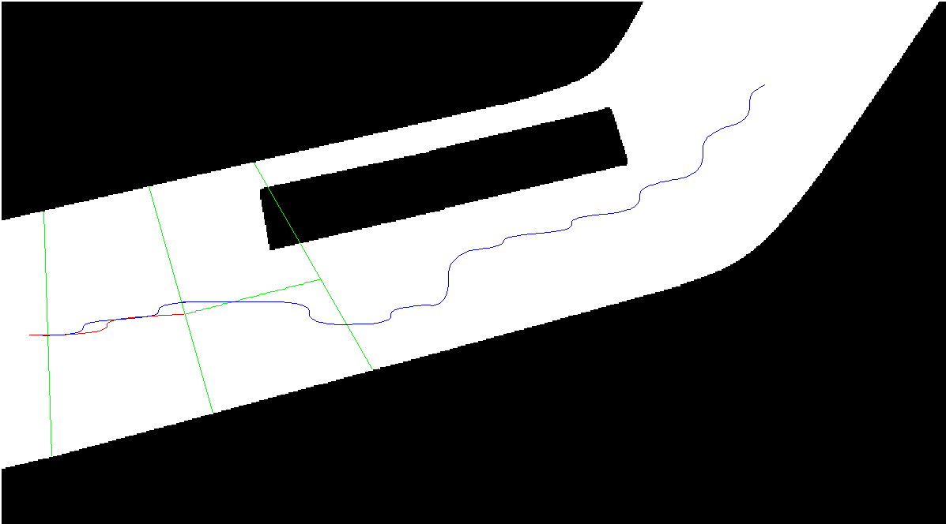
Free State Expansion
R_{j}
Original lane of R_{j}
R_{i}
Planned position of R_{i}
(b)
Modified lane of R_{j}
Z
Z₂
Lane of R_{i}
Planned position of R_{j}
(a)
Distribution of lanes amongst vehicles
Computing lane vehicles
Trajectory of R_{j} planned
Trajectory of R_{j} already covered
(this point and before)
Trajectory of R_{i}
Generated trajectories for vehicles

Slide 32
Vehicle Following
Select the vehicle to follow
Follow the selected vehicle
Laterally closest vehicle is selected
Speed is fixed to allow following with some distance
Z₂ is taken as per reduced speed
Rest expansion same as free state expansion
Z is taken as per normal speed

Slide 33
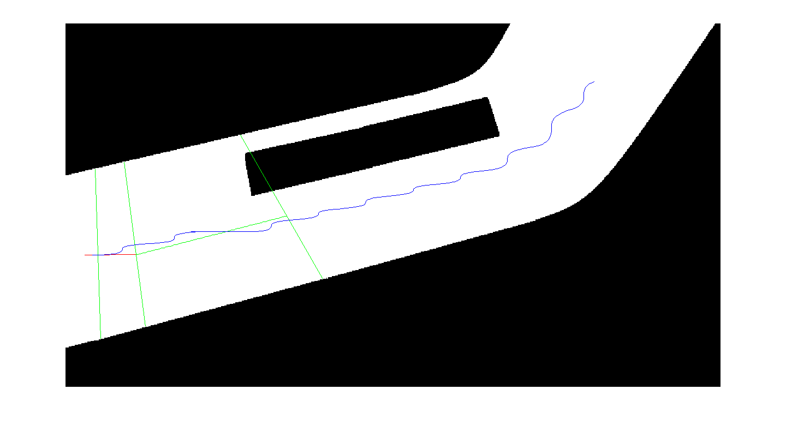
Vehicle Following
Z
Z₂
Trajectory of R_{j} planned
Trajectory of R_{j} already covered
(this point and before)
Trajectory of R_{i}

Slide 34
Wait for Vehicle
Consider a narrow bridge with a stream of vehicles coming from one side
Plan to wait for some of the vehicles in the stream to clear and hence go forward

Slide 35
Wait for Vehicle
Decide the vehicle to wait for
Compute the position/ trajectory to wait
Modify other vehicle’s trajectories
Compute state after wait
Attempt for all vehicles in the crossing stream
Number of state expansions = number of vehicles in stream

Slide 36
Computing the position of wait
Assume obstacle analysis line (Z) lies inside the narrow bridge
Assume previous line (Z₂) lies outside the narrow bridge in a wide region
Maximum separation threshold is left
Two options to wait: Left of the leftmost vehicle in the stream, or Right from the rightmost vehicle in the stream
Whichever has minimum deviation from current position is selected

Slide 37
Modification of Trajectories
Modify trajectory for the vehicle being waited for
Calculate time when it crosses the vehicle being planned
Modify trajectories of all other vehicles till this time
Get a snapshot of state after wait and use as the expanded state
Compute trajectory of the vehicle being planned
Calculate positions around waiting vehicle at Z₂
Set the lateral position as constant in this region
Hence all overtaking and like behaviours get cancelled

Slide 38
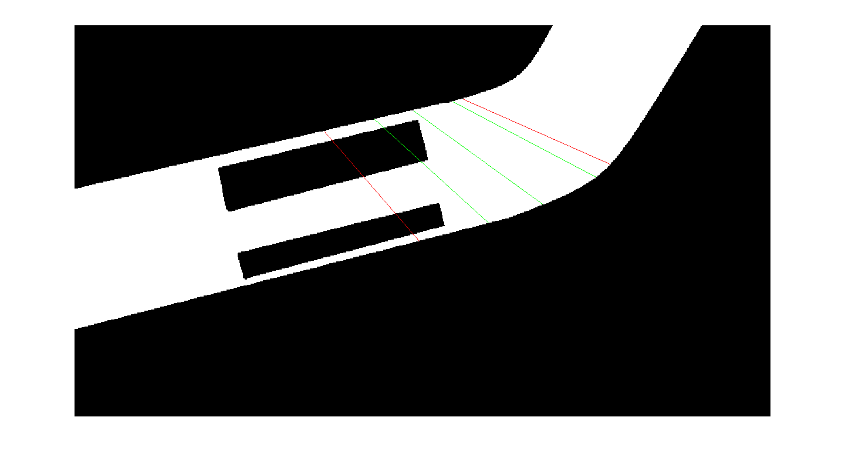
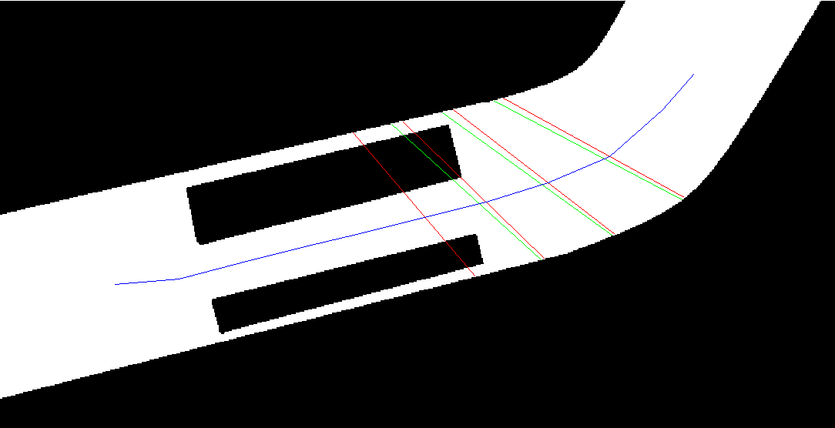
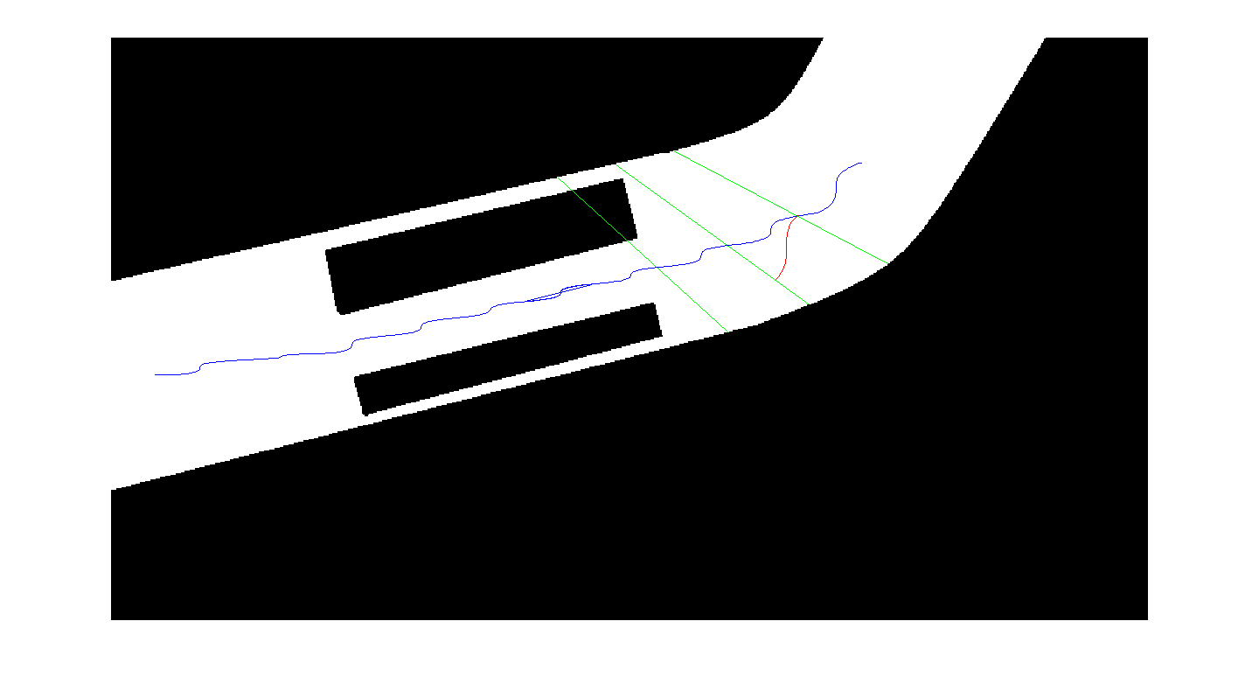
Wait for Vehicle Strategy
Z₂
Z₂
Z₂
(b)
Z
(a)
R_{i}
R_{k}
Planned position of R_{i}
Lane of R_{k}
Detection of sudden narrowing of width of road
Modification of lane of R_{i}
Trajectory of R_{k}
Trajectory of R_{i}
The generated trajectory for vehicles

Slide 39
Expansion strategy selection
All 3 strategies used for all state expansions results in too many expanded states
To limit expansions following heuristic rule is used
Strategy | Precondition
Free State Expansion | Parent state was expanded by free state expansion and no new vehicle encountered/left, a new vehicle encountered/left
Vehicle Following | Parent state was expanded by vehicle following and no new vehicle encountered/left, a new vehicle encountered/left
Wait for vehicle | Sudden change in road width used for obstacle assessment
Once decided to overtake/ follow a vehicle, continue doing so till a new vehicle approaches or leaves (changing overtake scenario)

Slide 40
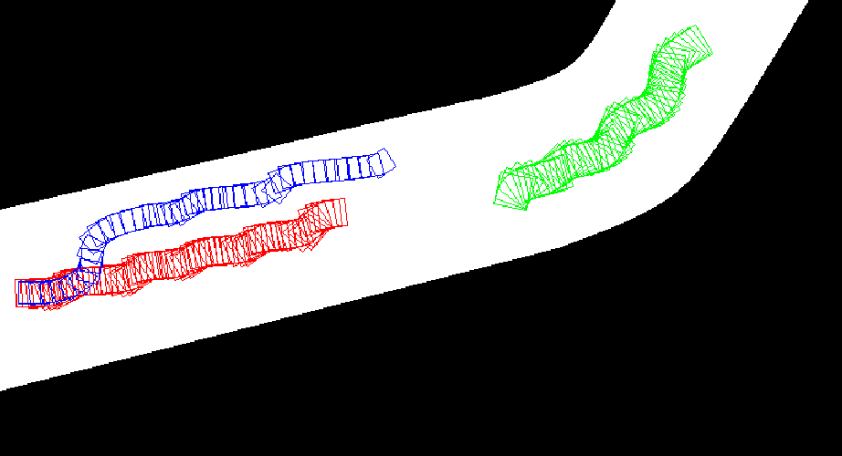
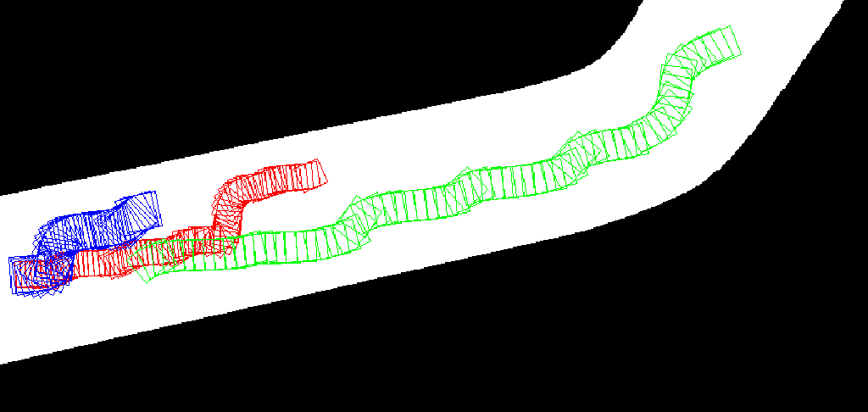
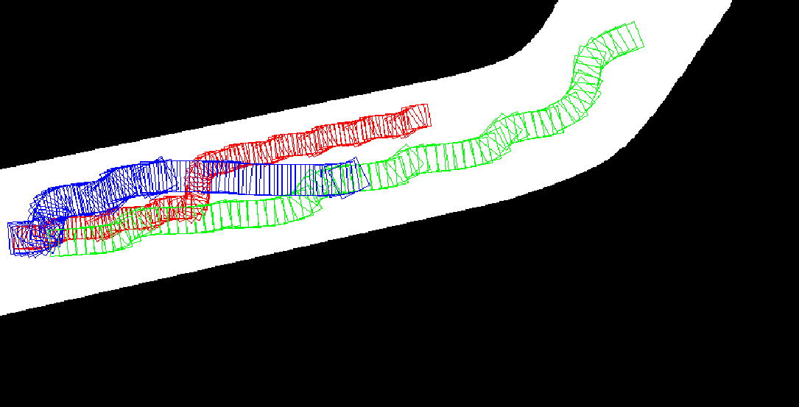
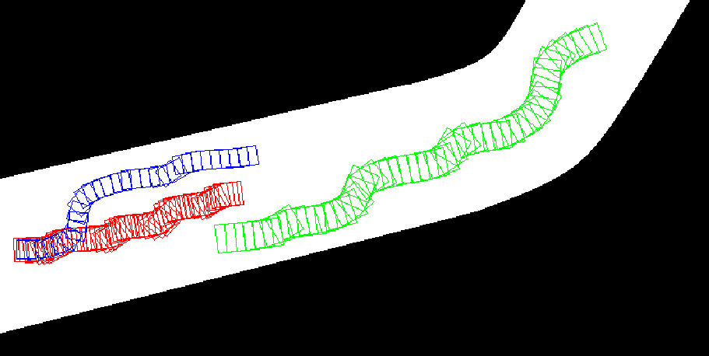
Results

Slide 41
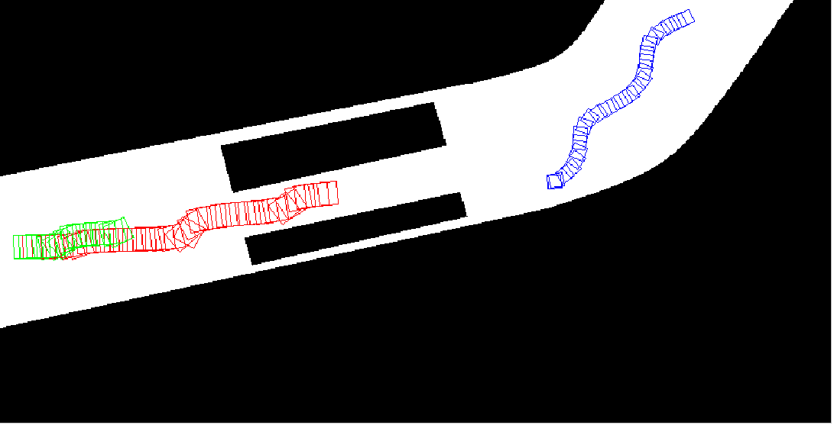
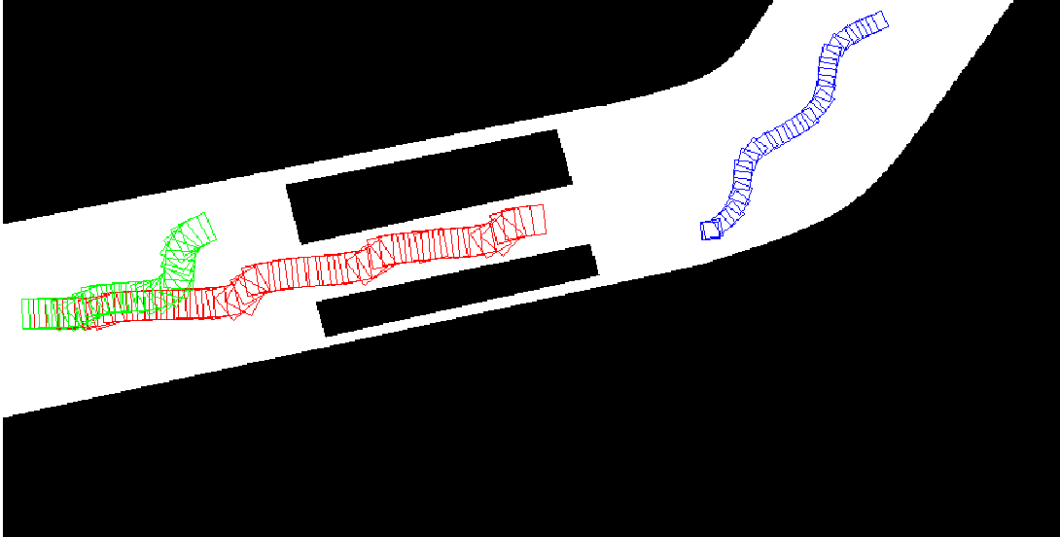
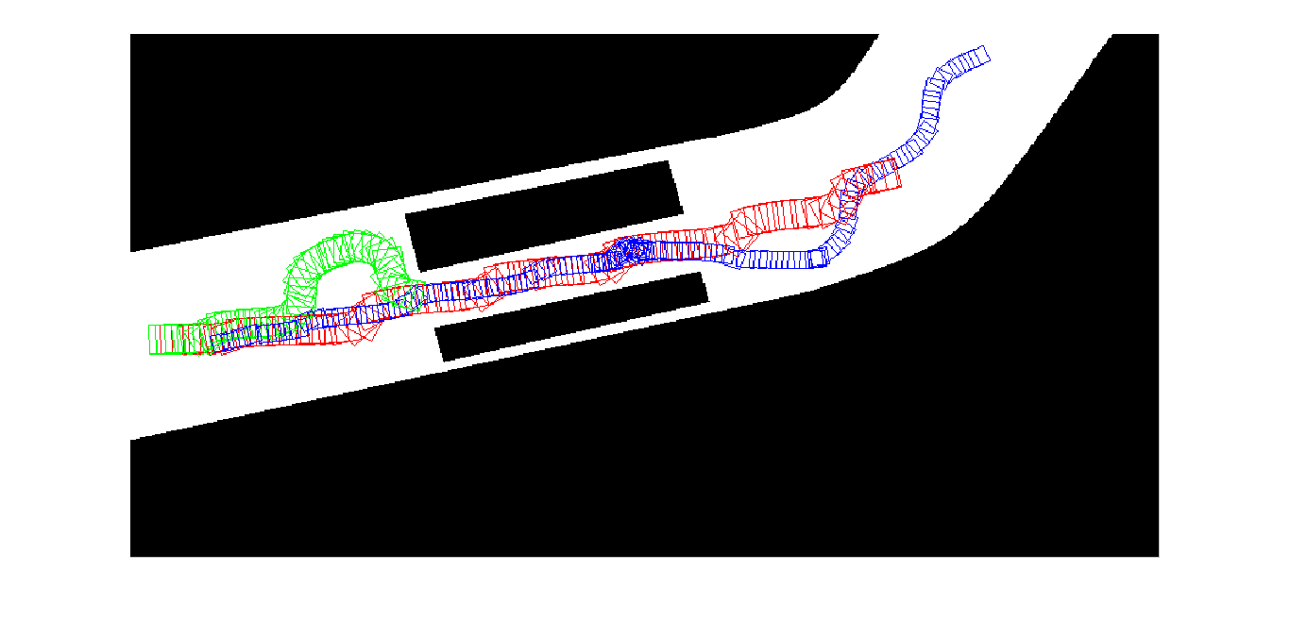
Results

Slide 42
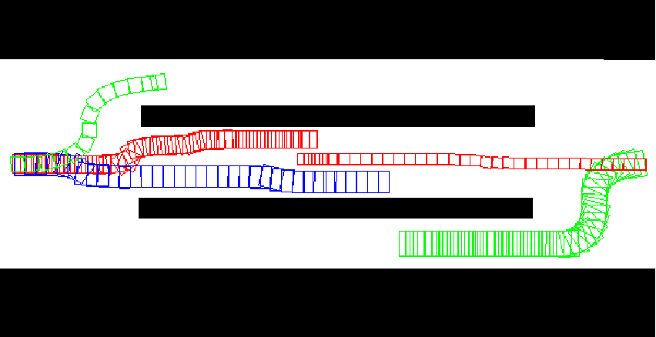
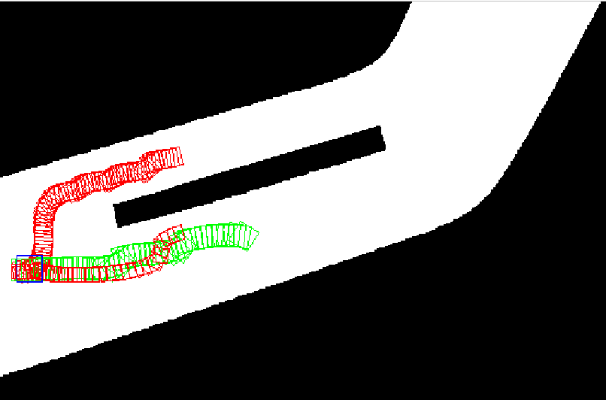
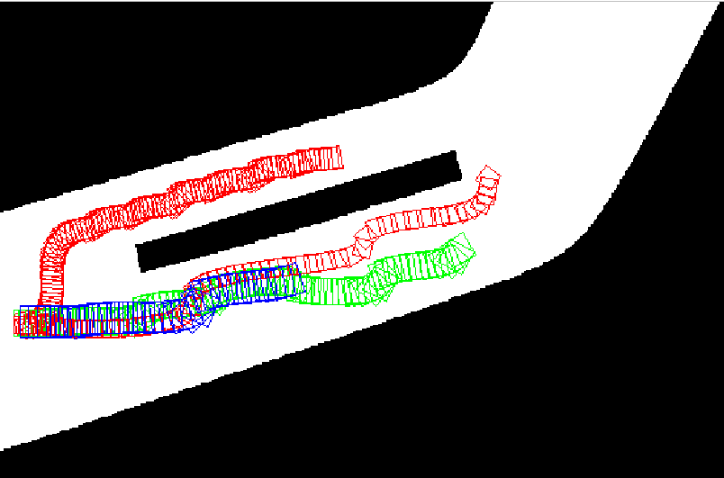
Results

Slide 43
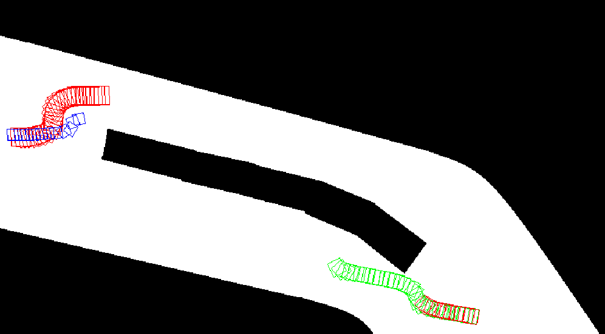
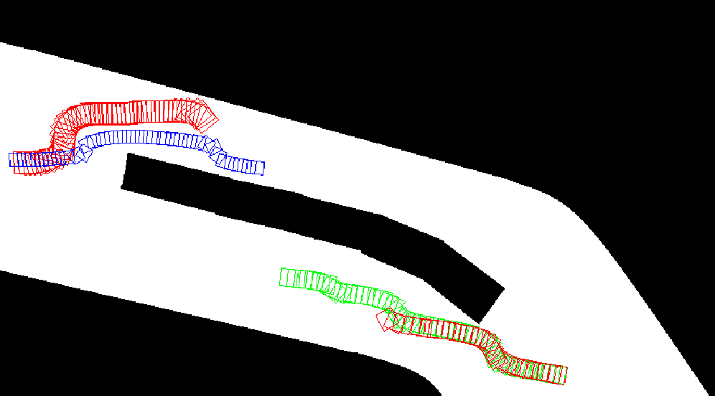
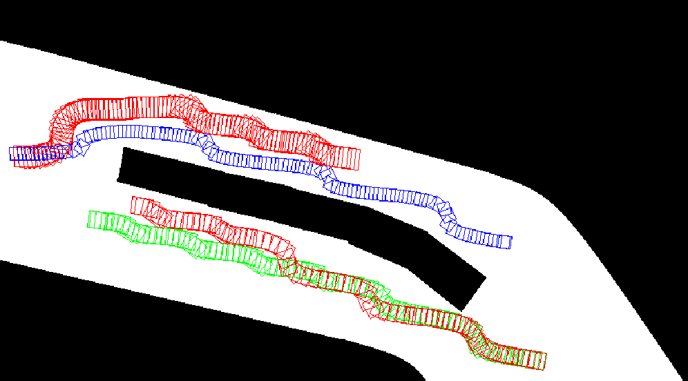
Results

Slide 44
Analysis

Slide 45
Analysis

Slide 46
Thank You
Acknowledgements:
Commonwealth Scholarship Commission in the United Kingdom
British Council

