Slide 1
Motion Planning for Multiple Autonomous Vehicles
Rapidly-exploring Random Trees
Rahul Kala
Presentation of paper: R. Kala, K. Warwick (2011) Multi-Vehicle Planning using RRT-Connect, Paladyn Journal of Behavioural Robotics, 2(3): 134-144.

Slide 2
Key Contributions
Inspired by the general motion of vehicles in traffic, a planning strategy is proposed which is biased towards a vehicle’s current lateral position. This enables better tree expansion and connectivity checks.
RRT generation is integrated with spline based curve generation for curve smoothing.
The approach is designed and tested for many and complex obstacles in the presence of multiple vehicles.

Slide 3
Why RRT
Computational expense (better than GA)
Probabilistically complete
Concerns
Sub-optimal

Slide 4
RRT
Tree-based representation
Random point is sampled in the solution space
Closest node in the tree is selected and is extended towards the sampled point by a constant called the step size.
Extended node is added to the tree with the sampled node as parent

Slide 5
RRT Expansion
First expansion in the heading direction of the vehicle
Samples generated using road coordinate axis system
Sampling biased towards current lateral position of the vehicle

Slide 6
RRT Expansion
Goal
Source and direction

Slide 7
Curve Smoothing
Spline curves used for smoothing of every expansion
Smoothened tree used for checking:
Feasibility
Smoothness (non-hololomic constraints)
Collisions with the other vehicles

Slide 8
Curve Smoothing

Slide 9
Coordination
Priority based coordination
Speed iteratively reduced till RRT finds a feasible path

Slide 10
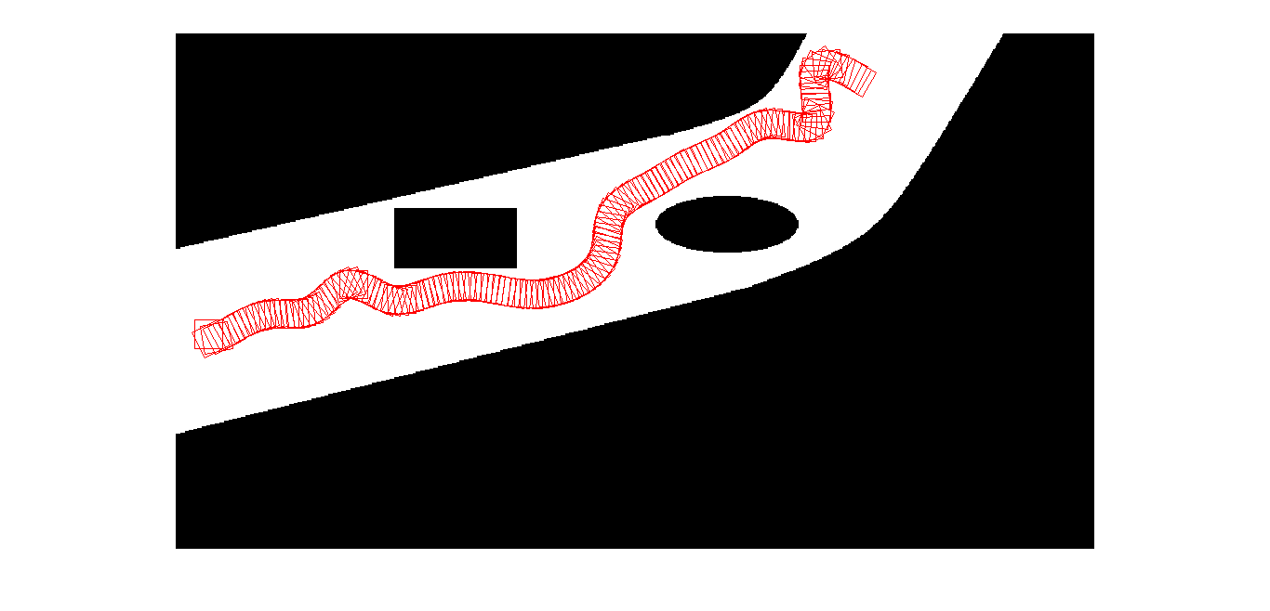
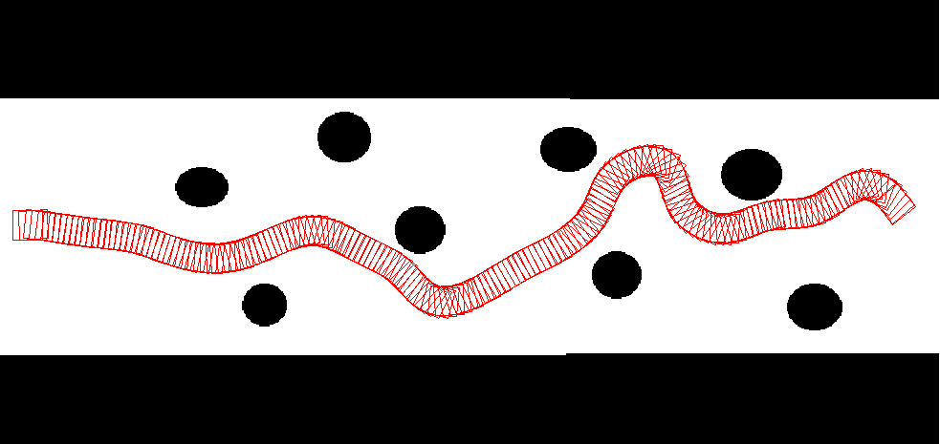
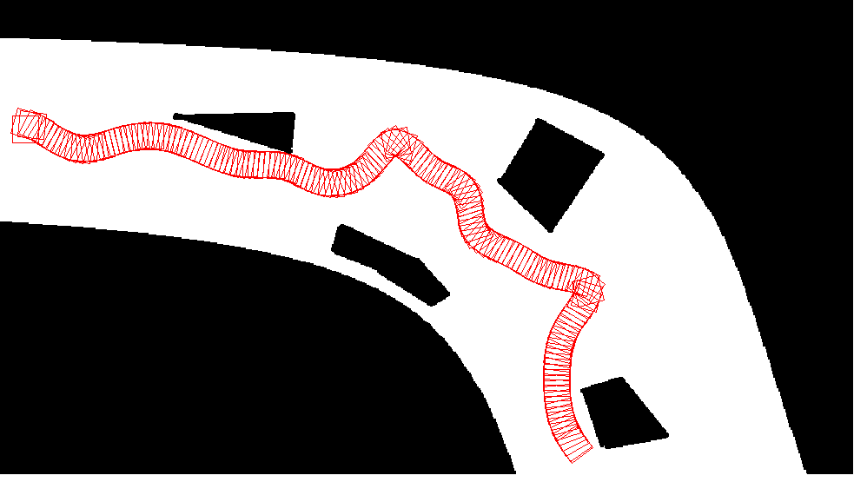
Results – Single Vehicle

Slide 11
Generated RRT

Slide 12
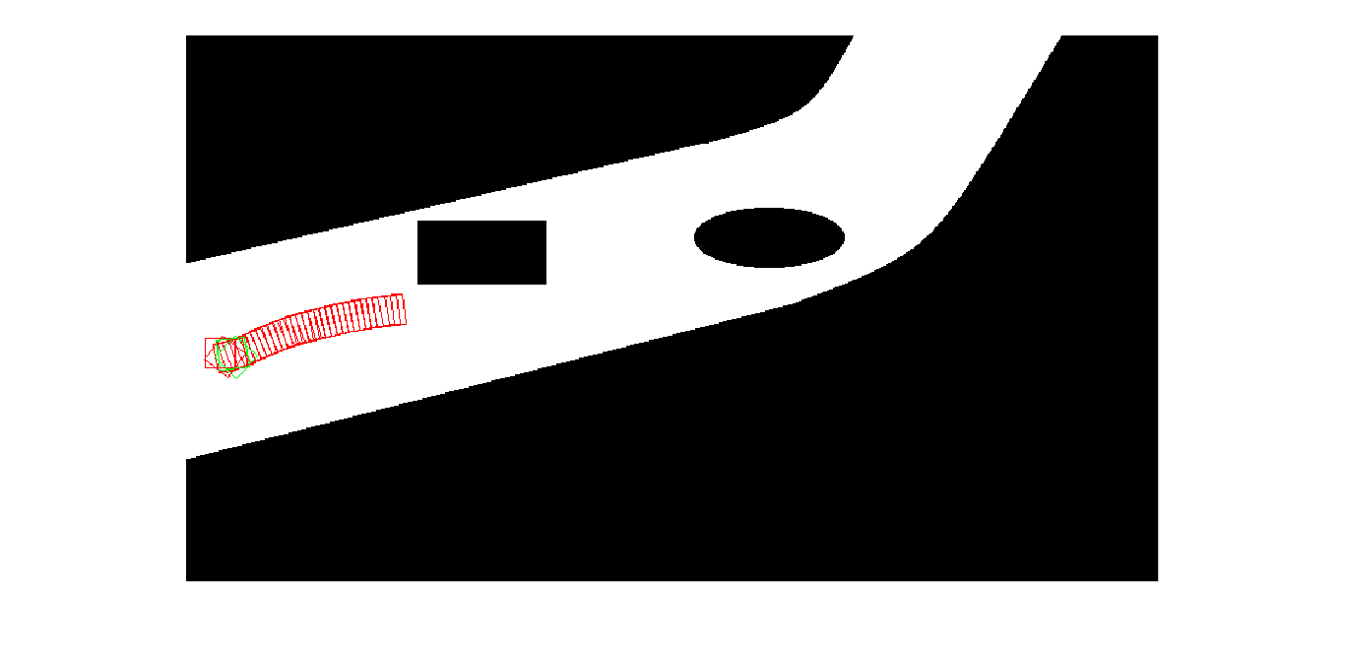
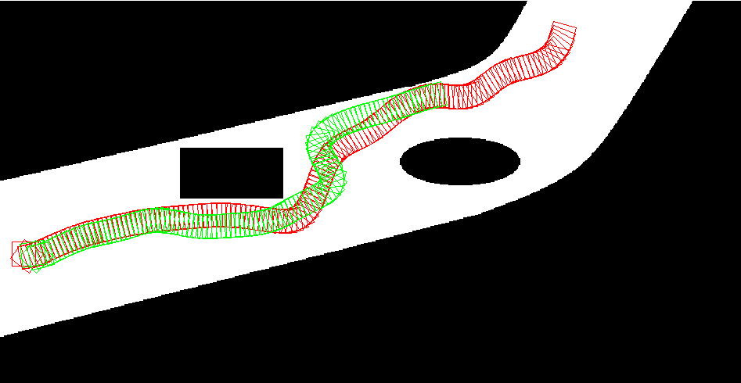
Results – Multi Vehicle

Slide 13
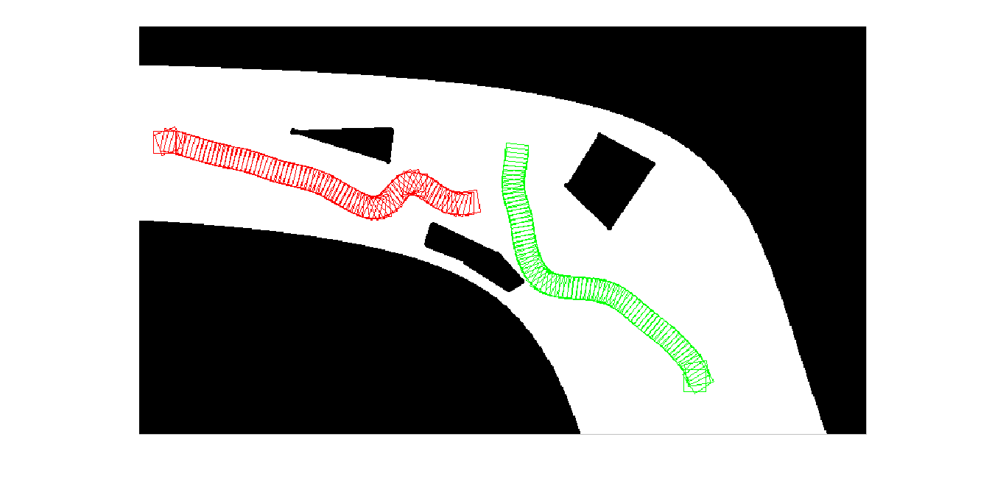
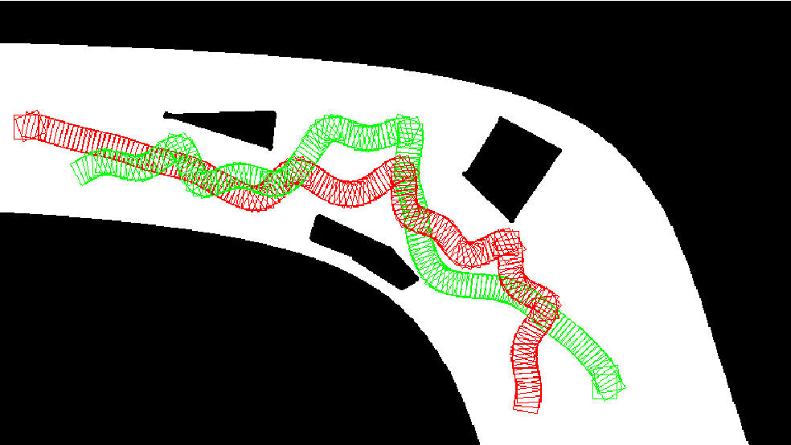
Results – Multi vehicle

Slide 14
Analysis

Slide 15
Analysis

Slide 16
RRT-Connect
In addition to RRT, extension is carried out in the extended direction to check a direct connectivity to the goal

Slide 17
Key Contributions
The planning algorithm can be used with very low computational requirements for very simple behaviours, while higher computation may enable near-optimal performance.
A decision making module is proposed for choosing between vehicle following and overtaking behaviours. The module relies on a fast planning lookup.
The algorithm uses the notion of first building an approximate path and then optimizing it which induces an iterative nature to the algorithm, unlike the standard RRT approaches which invest computation to build a precise path.
The algorithm uses multiple RRT instances to be assured of being near global optima, which is largely possible due to the fast approximate path construction.

Slide 18
Key Concepts
No curve smoothing used in RRT generation to save computations, smoothness approximately checked
Vehicle following behaviour takes unit computation, only 1 node expanded which has a direct connectivity to the goal

Slide 19
Local Optimization
RRT-Connect called multiple times for global optimality – best solution worked further
Local optimization used on the best solution induce local optimality
Spline curves are used in local optimization

Slide 20
Coordination
Priority based coordination
Speed
For vehicles in the same direction: If you cannot overtake, follow – Speed equal to the heading vehicle
For vehicles in the opposite direction: Decrease speed iteratively till a feasible plan is reached

Slide 21
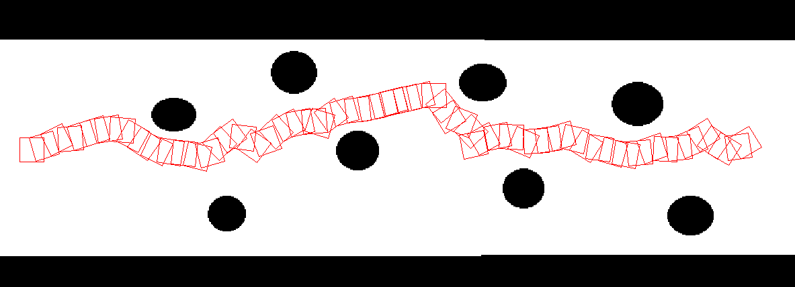
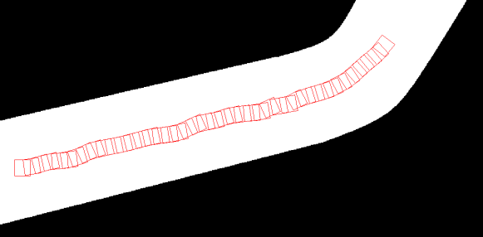
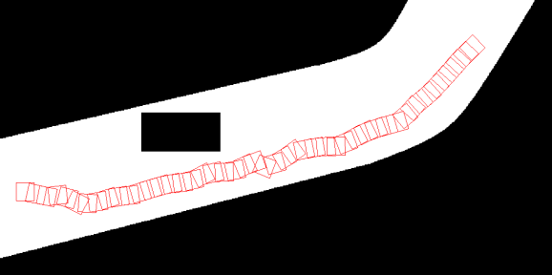
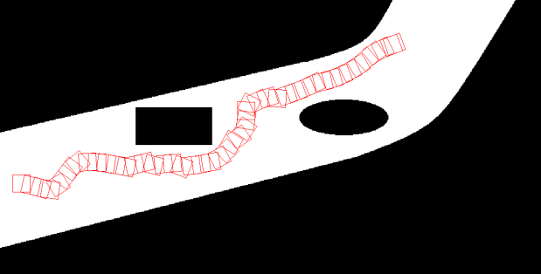
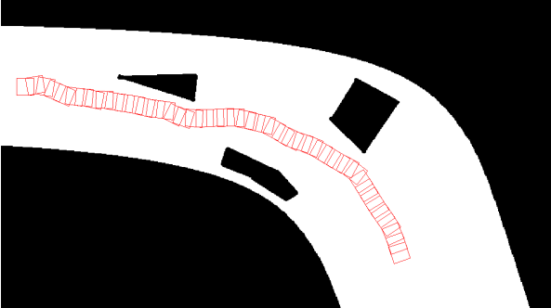
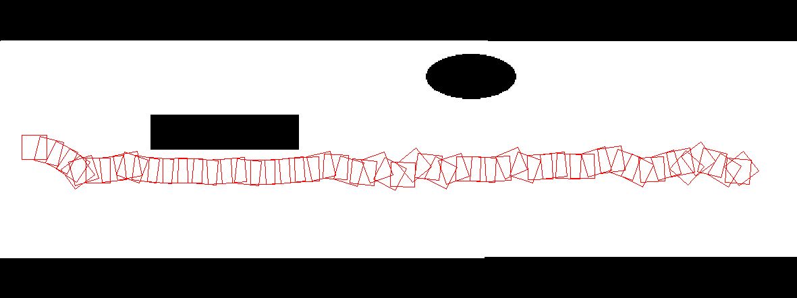
Results – Single Vehicle

Slide 22
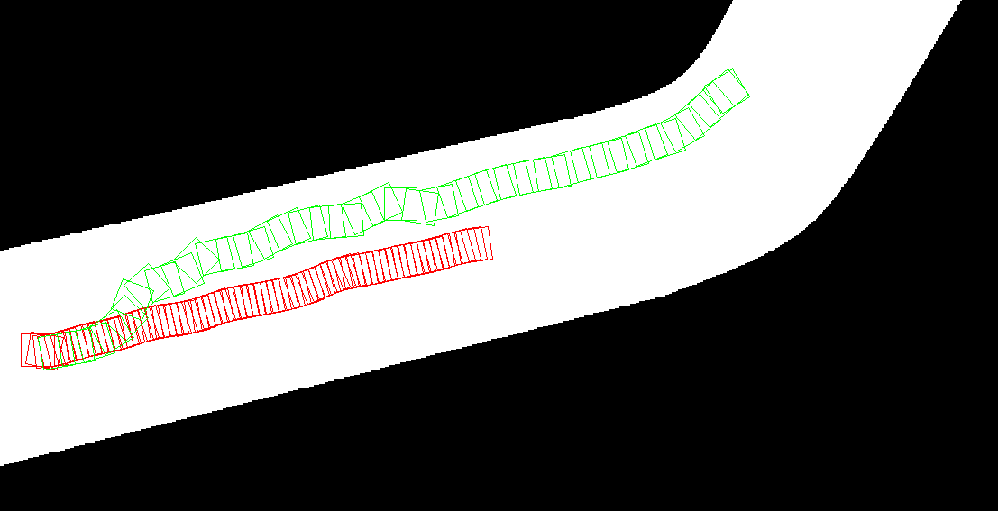
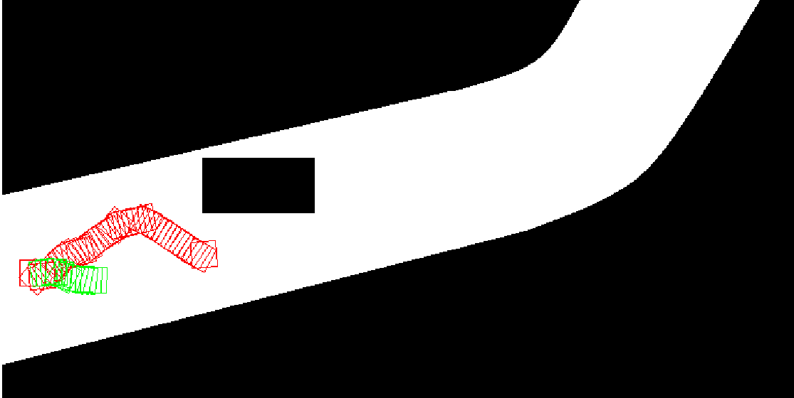
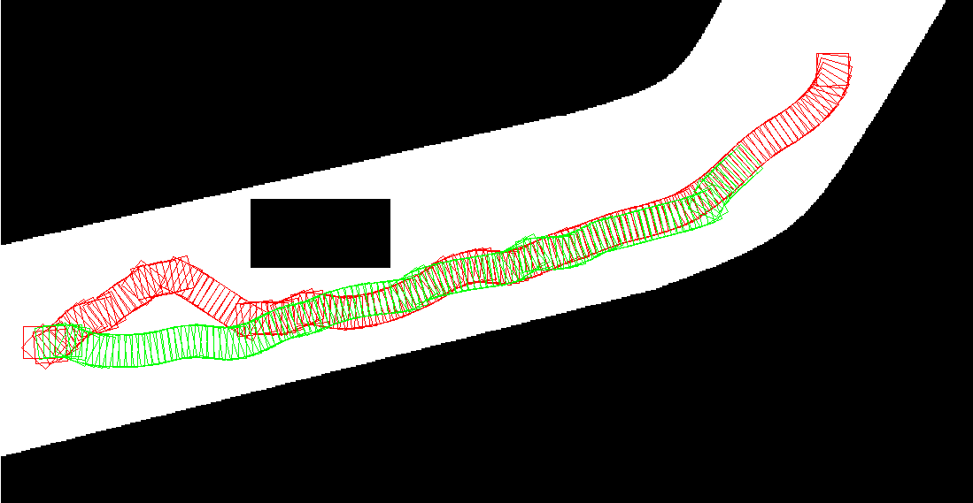
Results - Multi Vehicles

Slide 23
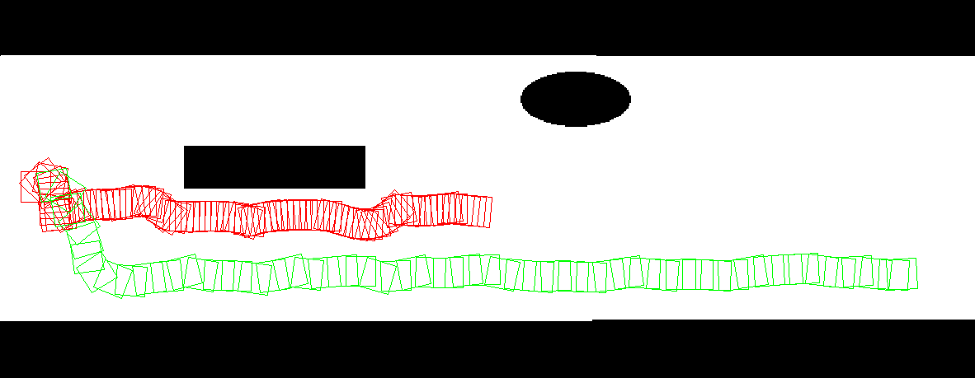
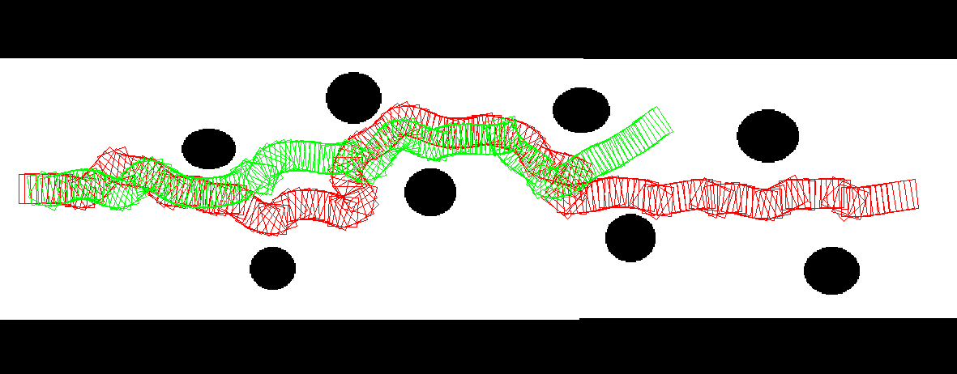
Results – Multi Vehicle

Slide 24
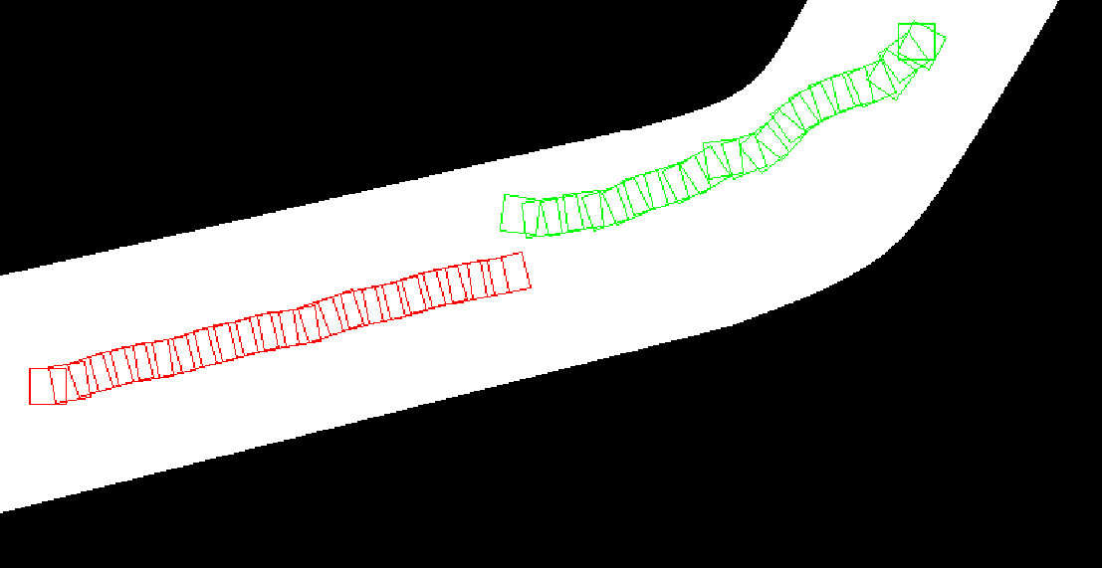
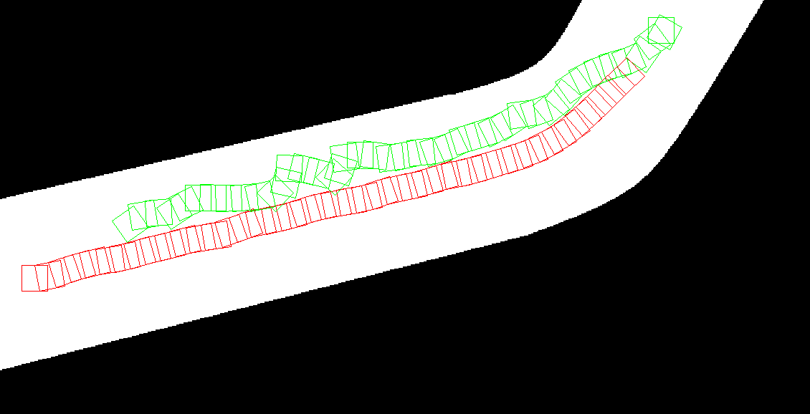
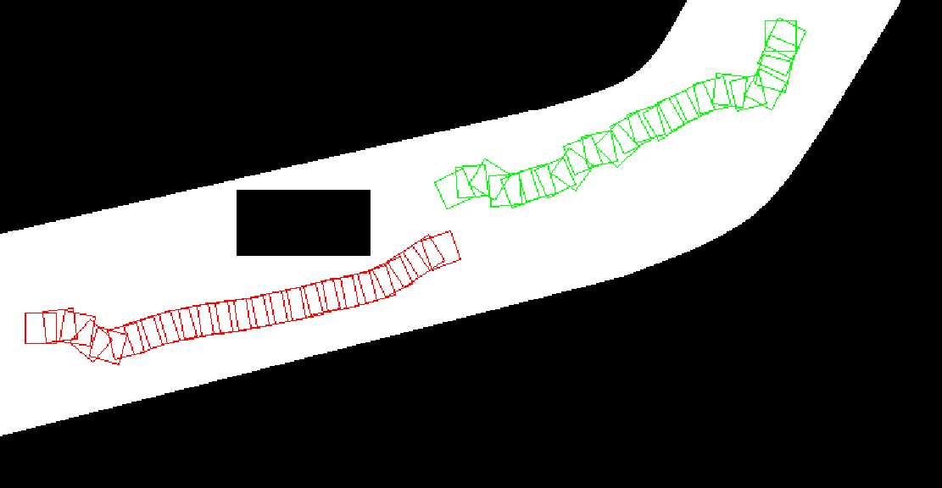
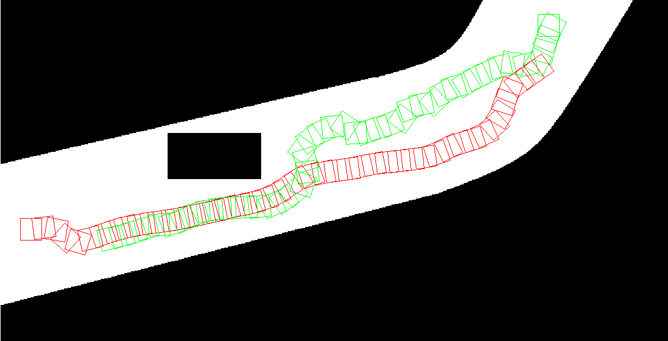
Results – Vehicle Avoidance

Slide 25
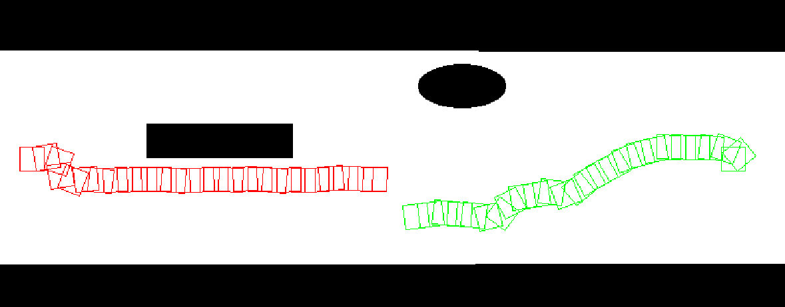
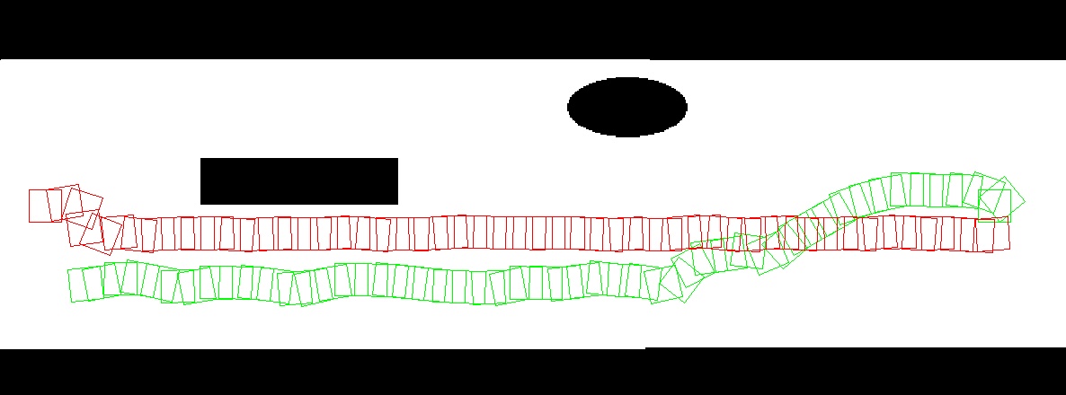
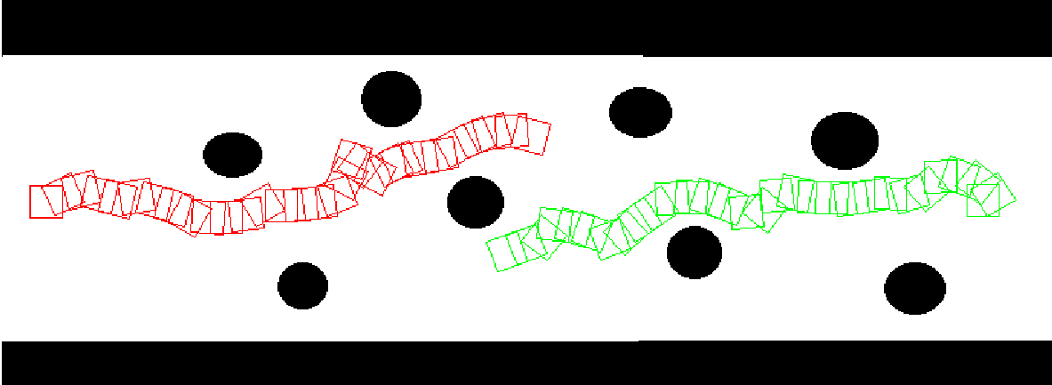
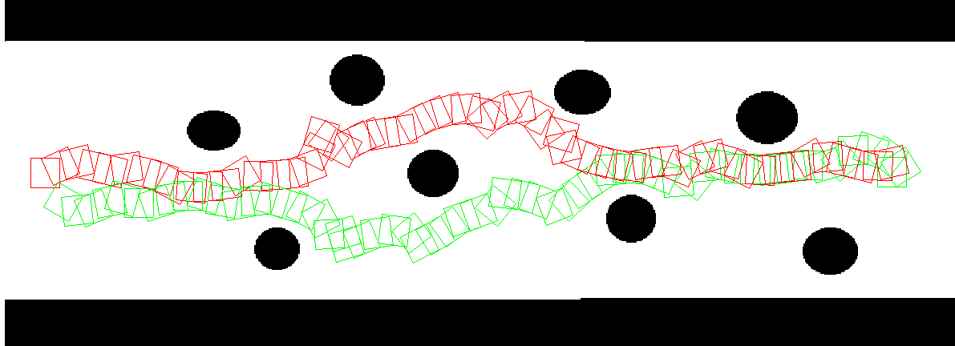
Results – Vehicle Avoidance

Slide 26
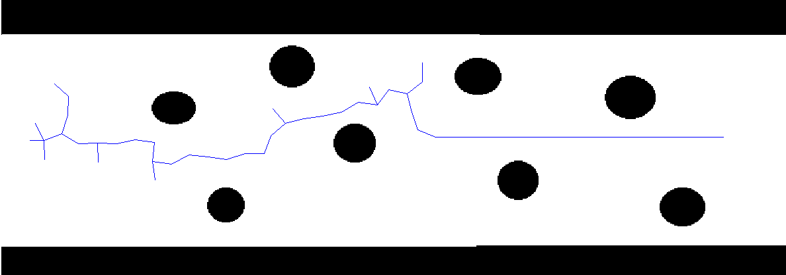
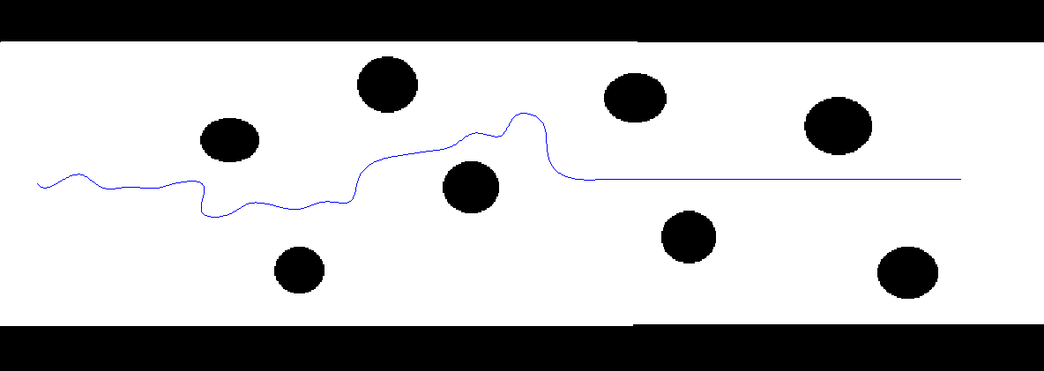
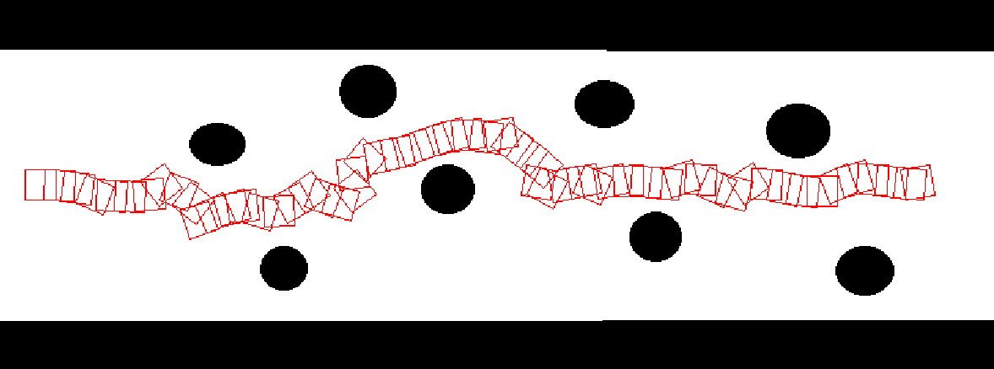
RRT Generation

Slide 27
RRT Generation – 2 Vehicles

Slide 28
Analysis

Slide 29
Thank You
Acknowledgements:
Commonwealth Scholarship Commission in the United Kingdom
British Council

