Slide 1
Motion Planning for Multiple Autonomous Vehicles
Genetic Algorithm
Presentation of the paper: R. Kala, K. Warwick (2014) Heuristic based evolution for the coordination of autonomous vehicles in the absence of speed lanes, Applied Soft Computing, 19: 387–402.
Rahul Kala

Slide 2
Key Contributions
The design of a GA which gives results within low computational times for traffic scenarios.
Employment of the developed GA for constant path adaptation to overcome actuation uncertainties. The GA assesses the current scenario and takes the best measures for rapid trajectory generation.
The use of traffic rules as heuristics to coordinate between vehicles.
The use of heuristics for constant adaptation of the plan to favour overtaking, once initiated, but to cancel it whenever infeasible.
The approach is tested for a number of diverse behaviours including obstacle avoidance, blockage, overtaking and vehicle following.

Slide 3
Why GA?
Optimality
Probabilistic Completeness
Iterative
Concerns
Computational Cost
Cooperative Coordination

Slide 4
Key Concepts
Use Road Coordinate Axis system
Optimize as the vehicle moves:
Tune plan
Overcome uncertainties
Compute feasibility of overtake
Integration with route planning
Next road/segment becomes the goal as the vehicle is about to complete the previous

Slide 5
Overall Algorithm
Map
For each vehicle entered in scenario and not reached goal
Planning by Dijkstra’s Algorithm if coarser path is not built
Finer Planning by Bezier Curves
Genetic Algorithm Optimization
Blockage?
Database of all Vehicle Trajectories
Yes
No
Operational Mode
Path Following
Overtaking
Vehicle Following
Steering and Speed Control

Slide 6
GA Optimization

Slide 7
Individual Representation
Genotype
 | Y’
X’
Y’
Mapping
Mapping
Control points
Source
Directional maintenance points
Goal
Phenotype
Trajectory
The genotype (optimized by GA) stores all control points of the spline curve

Slide 8
Genetic Operators
Repair
Sorts points in X’ axis (vehicle always drives forward)
Insert
Add random individuals
Crossover
For variable length chromosome
Mutation
Randomly deviate points
Deletes points behind the crossed position
Deletes excess control points till trajectory gets better

Slide 9
Fitness Function
Contributors
Length
Length of trajectory in without safety distance
Length in infeasible region

Slide 10
Checking Granularity
Points of checking
Finer at start
Trajectory
Coarser at the end

Slide 11
Coordination
Priority based coordination
Only vehicles ahead considered
Cooperation added by traffic heuristics
Overtake
Vehicle Following
Vehicle can request another vehicle to
Slow down
Turn right/left

Slide 12
Determination of speed
Path Optimization: GA
Speed Optimization
Alternating optimization of path and speed
Increase by δ if feasible
Decrease by δ if infeasible
Genetic Algorithm

Slide 13
Traffic Heuristics
Two heuristics used: Overtaking and Vehicle Following
Imparts cooperation to an else non-cooperative coordination

Slide 14
Traffic Heuristics
Assess Situation
Overtaking
Give initial turns to the other vehicles to best overtake
Alter speeds of the other vehicles to best overtake
Vehicle Following
Give initial turns to the other vehicles to best overtake
Cancel overtake if it seems dangerous
Alter speeds of the other vehicles to best overtake
Initiate overtake if it seems possible

Slide 15
Overtaking
Move Left
Move Left
Move Left
Move Left
R₁
R₂
R₃
R₁
R₂
R₃
R₂
R₂
R₁
R₁
R₃
R₃
R₂
R₂
R₁
R₁
R₃
R₃

Slide 16
Overtaking
Too close, R₂ slows
Too close, R₃ slows
R₂
R₂
R₁
R₁
R₃
R₃
Not possible, abandon
Not possible, abandon
R₂
R₂
R₁
R₃
R₁
R₃

Slide 17
Vehicle Following
Move Left
Move Left
R₂
R₁
R₃
R₁
R₂
R₃
Feasible, speed up
Infeasible, slow down
Move Left
R₂
R₁
R₃
Infeasible, slow down
R₁
R₂
R₃
Move Left
R₂
R₃
R₁
R₁
R₂
R₃

Slide 18
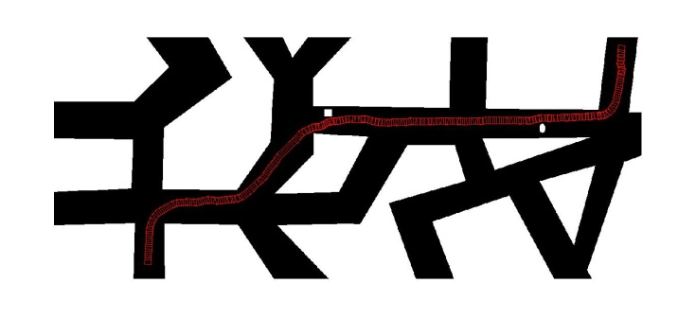
Results
Vehicle position at the time of blockage
Blockage

Slide 19
Results - 2 vehicle
b

Slide 20
Results - Overtaking

Slide 21
Results – Vehicle Following

Slide 22
Analysis

Slide 23
Analysis

Slide 24
Analysis

Slide 25
Analysis

Slide 26
Thank You
Acknowledgements:
Commonwealth Scholarship Commission in the United Kingdom
British Council

