Slide 1
Motion Planning for Multiple Autonomous Vehicles
Introduction
Rahul Kala

Slide 2
Autonomous Vehicles
Safety
Efficient Driving
Jam Avoidance
Coordination
Comfort

Slide 3
Software Architecture
Environment understanding
Environment
Sensor
Localization
Sensor fusion
Planning
Control
Motion
Map
Mission

Slide 4
Thesis
Thesis
Trajectory Generation
Intelligent Management of the Transportation System

Slide 5
Trajectory Generation
Static Obstacles
A
B
C
a
Select the best plan:
(a) A overtakes B from right, B drifts left, A crosses the obstacles, C waits, (b) A follows B and both cross the obstacles while C waits,
(c) B crosses the obstacles followed by C and A,
(d) C crosses the obstacle a from its left, while A follows B to cross the others

Slide 6
Key Contributions
Various aspects of unorganized traffic (operating without lanes) are studied.
The problem of trajectory planning for unorganized traffic in a diverse multi-vehicle scenario is studied, while the literature is largely focussed on the study of the organized counterpart.
The algorithm framework is generalized to the cases in which traffic intermingles on both sides of a dual carriageway (or the vehicles partly occupy the wrong side) for higher traffic efficiency (usually implying overtaking).
A new coordinate axis system called the road coordinate axis system is designed for enhanced performance with curved and variable width roads.

Slide 7
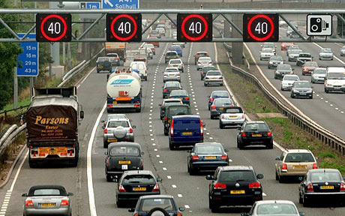
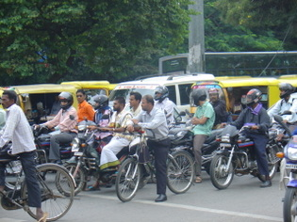
Organized and Unorganized Traffic
Unorganized
Organized
Image Courtesy: railway-technical.com, blogs.abc.net.au/

Slide 8
Unorganized Traffic
Advantages
Larger Traffic Bandwidth
Disadvantages
More overtakes/ more efficient
Safety
Non-Clearer Intentions
Large Lateral Movements
Less driving comfort
Larger travel distances

Slide 9
Unorganized Traffic
When better?
Diverse widths
Diverse speeds
Migration from Organized to Unorganized?
Motorists driving in between lanes
E.g. Indian traffic!
Intelligent Vehicles will bring diversity
Current Defiance of lanes:
Is future diverse?
Speed diversity necessitates overtakes
Overtakes by emergency vehicles

Slide 10
Layers of Planning
Sub-strategic - Route Planning
Middle tier – Validation, re-planning, plan extension
Trajectory generation
Strategic – Where to go and in which order
Control
Merging
Intersections
Parking
Blockage
Normal roads
Abstraction

Slide 11
Continual Planning
Vision
Vehicle current position
Planning as the vehicle moves
Immediate Move
Trajectory generation
Trajectory validation
Trajectory extension

Slide 12
Per-Segment Planning
Segment 2
Segment 1
Segment 3
Vehicle current position
Obstacle
Planned trajectory for segment 1
Vehicle planned position
Overlapping segment breakup
Moving by planned trajectory in segment 1 with a segment 1 only vision would result in vehicle coming too close to the obstacle. Hence segments are overlapped and the vehicle is re-planned at the entry of segment 2.

Slide 13
Communication – if available
Communication
Obstacle Discovery
Localization
Collision Avoidance
Travel Plan
Communication
Vehicle 1
Vehicle 2
Vehicle 3
….
Vehicle n

Slide 14
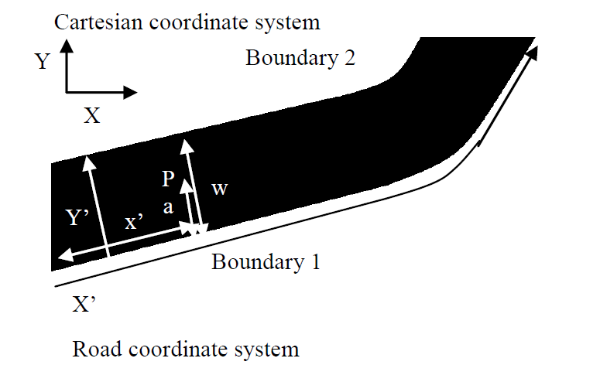
Road Coordinate Axis System
Better suited for
Curved roads
Irregular width roads

Slide 15
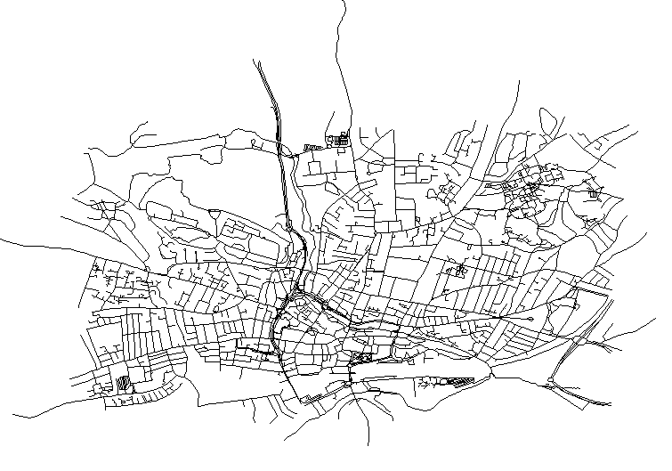
Intelligent Management of the Transportation System
Road map of Reading, United Kingdom

Slide 16
Key Contributions
The study is based upon the notion of diversities, which may be speed based diversity or task based diversity.
Both recurrent and non-recurrent traffic is studied to overcome congestion avoidance which means applicability to any region depending upon its dynamics.
The different models studied vary from being mostly semi-autonomous to mostly non semi-autonomous, which covers all the stages of the evolution of traffic.
Different traffic elements including traffic lights, lane changes and routing are incorporated in the study.

Slide 17
Intelligent Management of the Transportation System
Dynamic Traffic Management
Experiment new traffic behaviours
Traffic light, Dynamic Speed Lanes
Congestion Avoidance
Non-recurrent traffic
City based scenario
Reaching Destination before Deadline
Route and Start Time Determination
Lane Booking, Road Booking
Density Regularization, Blockages, Re-routing
Short frequent re-planning
Single lane overtakes
Density and Traffic Light avoidance
Recurrent Traffic
Maximize probability of reaching on time and minimize wait time
Cooperative traffic lights and lane changes

Slide 18
Thank You
Acknowledgements:
Commonwealth Scholarship Commission in the United Kingdom
British Council

