Slide 1
Motion Planning of Autonomous Vehicles
Rahul Kala
Presentation of the paper: Kala, K. Warwick (2013) Motion Planning of Autonomous Vehicles in a Non-Autonomous Vehicle Environment without Speed Lanes, Engineering Applications of Artificial Intelligence, 26(5-6): 1588–1601.

Slide 2
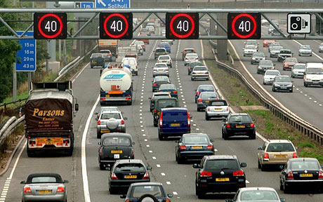
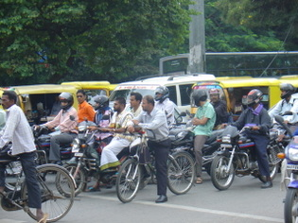
A run through the background
1. The Problem
2. The Traffic
(Speed Lanes)
Speed Diversity
Size Diversity
Task Diversity
3. The Transition
Image Courtesy: railway-technical.com, blogs.abc.net.au/

Slide 3
Vehicle Packing in Roads
Student Packing at 188, Call Centre Lab
v/s
Rahul Kala

Slide 4
Disclaimer
All characters and acronyms used in this presentation are fictitious. Resemblance to any student studying or passed out is purely coincidental

Slide 5
The Problem
Image Courtesy: SSE, UoR

Slide 6
The ‘Cause’ of the Problem
Vehicle Packing
Minimum road width
Maximum road width
Student Packing
Minimum Desk Space
Maximum Desk Space
1, 1.5, 2, entire row?
0.25, 0.5, 1 (lanes), entire road?

Slide 7
Objectives
Vehicle Packing
Maximize Separation
Join Vehicle Pool Ahead
Student Packing
Maximize number of desks
Desks with screen ‘hidden’ from door entry

Slide 8
The Approach
The rules of the GAME

Slide 9
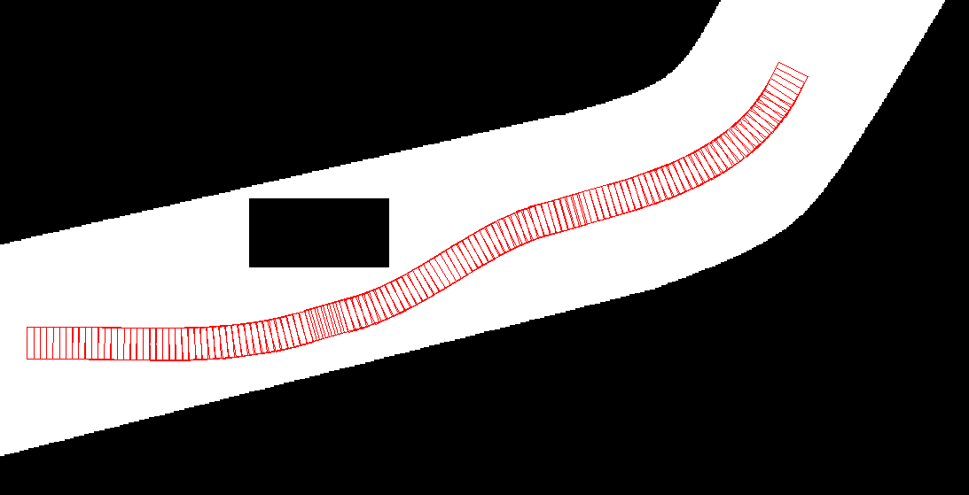
Rule 1: Obstacle Avoidance

Slide 10
Rule 1’: JR Replacement

Slide 11
Rule 2: Centring

Slide 12
Rule 2’: CK Expansion

Slide 13
Rule 3: Lane Change
Would it be OK to turn??

Slide 14
Rule 3’: S-P-R-E-A-D Meetings
Would it be
OK to change??

Slide 15
Rule 4: Overtake
Can I fit in??
Side? Place?

Slide 16
Rule 4: Overtake

Slide 17
Rule 4’: AM Jump

Slide 18
Rule 5-7: Single Lane Overtake
Initiation
Completion
Cancellation

Slide 19
Rule 5’-7’: Exits and Returns
MR Initiation
MA Initiation
MR Exit
MA Return

Slide 20
Rule 8: Be Overtaken

Slide 21
Rule 8’: CB Condensation

Slide 22
Rule 9: Maintain Separation Steer

Slide 23
Rule 9’: ImH/HS Shift

Slide 24
Rule 10: Slow Down

Slide 25
Rule 10’: CjS Retrieval

Slide 26
Rule 11: Discover Conflicting Interests

Slide 27
Rule 11’: MS/MS Confusion

Slide 28
Rule 12: Travel Straight

Slide 29
Rule 12’: Stay at your place!

Slide 30
To Summarize
Vehicle Packing
Obstacle Avoidance
Centring
Student Packing
JR Replacement
CK Expansion
Lane Change
Overtake
S-P-R-E-A-D Meetings
AM Jump

Slide 31
To Summarize
Vehicle Packing
Single Lane Overtake Initiation
Single Lane Overtake Completion
Student Packing
MR/MA Exit Initiation
MR Exit
Single Lane Overtake Cancelation
Be Overtaken
MA Return
CB Condensation

Slide 32
To Summarize
Vehicle Packing
Maintain Separation Steer
Slow Down
Student Packing
ImH/HS Shift
CjS Retrieval
Discover Conflicting Interests
Travel Straight
MS/MS Confusion
Stay at your place

Slide 33
And Some Robotics

Slide 34
Choices
since one turn at a time is modelled

Slide 35
Choices

Slide 36
Choices
since one turn at a time is modelled

Slide 37
Bounds
37

Slide 38
Thank You
Image Courtesy: wikimedia.org

