Slide 1
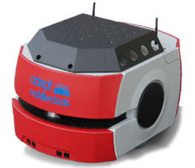
Dynamic Programming Accelerated Evolutionary Planning for Constrained Robotic Missions
Robotics and Artificial Intelligence Laboratory
Indian Institute of Information Technology, Allahabad
Research Sponsored By:
Rahul Kala
Presentation of the paper: R. Kala (2018) Dynamic Programming Accelerated Evolutionary Planning for Constrained Robotic Missions, In Proceedings of the IEEE Conference on Simulation, Modelling and Programming for Autonomous Robots, Brisbane, Australia, pp 81-86.

Slide 2
Example 1: Robot Motion Planning
Go for tea

Slide 3
Example 2: AND units
Go to washroom, and get banquet tickets, and go for tea and buy snacks

Slide 4
Example 3: Boolean Units
Go to any one washroom, and get banquet tickets from either chair, and go for tea and buy snacks

Slide 5
Example 4: Temporal Units
Go to any one washroom, then get banquet tickets from either chair and go for tea and buy snacks

Slide 6
Example 5: Missions
Go to any one washroom, then go for tea and buy snacks
AND
Get banquet tickets from either chair then report to registration desk

Slide 7
Generic Mission
Go to W₁ or W₂ or W₃, then go to T and S
AND
Go to C₁ or C₂ then Go to R

Slide 8
Another Example
Rahul Kala Task 1
Get coffee from the machine
Rahul Kala Task 2
Make payment for banquet dinner; THEN
Panel Chair Task 1
Panel Chair Task 2
Take session report to give to either of general chairs THEN
Get coffee from the machine
Get permission from any two of 3 registration chairs and any one of general chair; THEN
Report to registration desk to get banquet ticket THEN
deliver to RK
Submit session report to registration desk

Slide 9
Typical Approaches
Temporal Logic and Model Verification Methods
Evolutionary Planning
Optimal Solvers

Slide 10
Problem and Solution
Problem
Is it possible to solve for missions using evolutionary computation?
Solution
Integrate results of different task solvers to make a mission solver

Slide 11
Dynamic Programming Alignment
Tasks | Solution of Tasks | Sample Mission Solutions
Go to W₁ or W₂ or W₃, then go to T and S | W₂ ○ S ○ T | W₂ ○ S ○ T ○C₁ ○ R W₂ ○C₁○ S ○ R ○ T C₁ ○ R ○W₂ ○ S ○ T C₁ ○W₂ ○ R ○ S ○ T and so on
Go to C₁ or C₂ then Go to R | C₁ ○ R

Slide 12
Individual Representation
Tasks | Genes
Task 1 | W₂ | S | T
Task 2 | C₁ | R
Order
1
2

Slide 13
Genetic Operators
Mix of Combinatorial and Parametric
Heuristic Initial Population Generation
Combinatorial Crossover
Insert Gene
Delete Gene
Swap Gene
Change Gene
Scattered Crossover

Slide 14
Results

Slide 15
The Problem
The supervisor RK instructs the robot to get the request of an equipment verified by any two of his students, namely, Bishnu (29), Heena (28) and Racheal (21); and to further take the recommendation from any of the two postdocs namely, Ross (9) and Priyanshu (27). The robot should come with the signed document to Office RK (2).
Meanwhile, the person GCN has been reported a serious discipline issue by his students and calls the robot to his office (1) to get a document to be first noted by Joey (6) and thereafter delivered and signed receiving by all his students Monica (22), Divya (25) and Latika (26). The robot must finally take a photocopy of the receiving at the copying station (7), submit the photocopy to the office RK (2) and then give the original copy to the secretary’s office Mary (4).
The user Priyanshu (27) also calls the robot to collect his stipend sanction paper, get his approved leave printout at the office system (8), to be finally signed by the guide RK (2). The robot must also make a copy at the copying station (7).

Slide 16
Problem (cont.)
The robot is also simultaneously asked to prepare the classroom for a seminar, so the robot must switch on the lights (12), then switch on any two ACs out of the wall AC front (15), wall AC back (16), back right AC (17), back left AC (18). Then the robot must go to the left cupboard (23) or the right cupboard (24) to get a marker, and must return to the whiteboard (14) to wipe off the board and place the marker and to also switch on the projector (30).
The robot is also to ensure the security and make inspections to the Classroom Entrance (10), ROBITA entrance gate (3), waiting area (5) and Robita lab entrance (11) and then to report all findings in person to office of the secretary, Mary (4).
Finally, the robot must take attendance of all people, including RK (2), GCN (1), Mary (4), Joey (6), Heena (28), Bishnu (29), Racheal (21), Monica (22), Divya (25), Latika (26), Priyanshu (27) and Ross (9).

Slide 17
Results

Slide 18
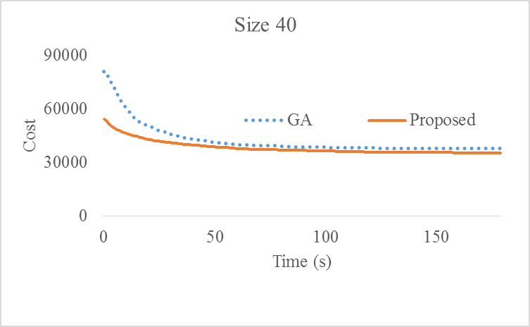
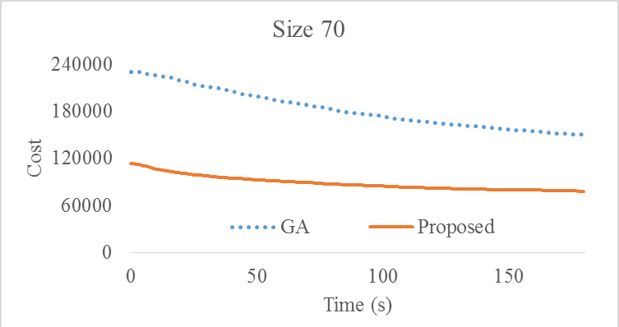
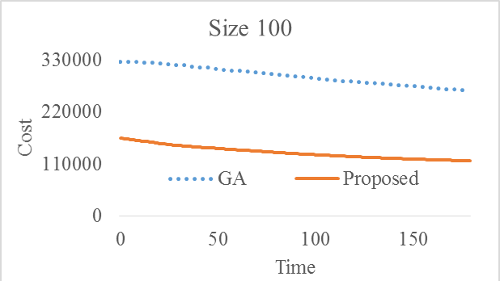
Analysis

Slide 19
Thank You

